Slide 1
Lexical Analysis
Course Textbook (Chapter 2 & 3)
Muhammad Haris
Lecturer Computer Science
Sukkur IBA University

Slide 2
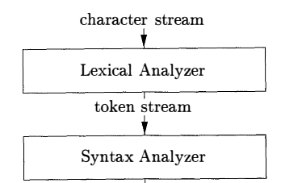
Lexical Analysis

Slide 3
Lexical Analysis
Lexical analyzer fills a parser with lexemes.
A sequence of characters comprises a single token is called lexeme.
Lexical analyzer reads character from the input and group into tokens.
A token is terminal with additional information (i.e. attribute value)

Slide 4
Fundamentals & Terminology
Terminology used in Lexical Analysis.
Token: A set of input string which are related through a similar pattern. Any word that starts with an alphabet and can contain any number or alphabet in between is called an Identifier.
It can be identifier, keyword, operator, special symbols or constant
Lexeme: The actual input string which represents the token.
Pattern: Rule which a Lexical analyzer follow to create a token.

Slide 5
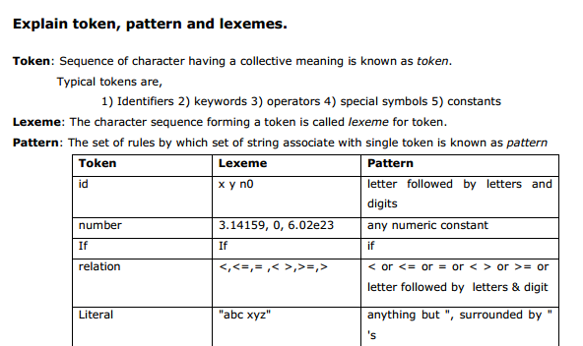

Slide 6
Tokens, patterns and lexemes
printf(“Total = %d\n”, score);

Slide 7

Tokens, patterns and lexemes
printf(“Total = %d\n”, score);

Slide 8
The Lexical Analyzer
Lexical: Anything related to words.
Main task of a Lexical Analyzer in Compiler Design
Process the input character that constitute a high level program in to valid set of token.
Skip the comment and white spaces while creating these tokens.
If any erroneous input is provided by the user in the program Lexical analyzer correlate that error with source file and line number.

Slide 9
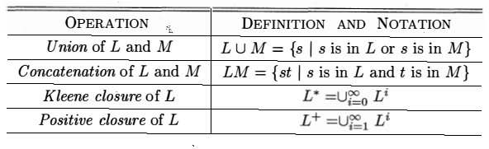
Operations on languages

Slide 10

Regular expression
L* is the set of ail strings of letters, including Ɛ the empty string.
D+ is the set of all strings of one or more digits.
L ( L U D)* is the set of all strings of letters and digits beginning with a letter.
If we include the underscore in L ( L U D)* , then it will be like a valid C identifier.

Slide 11
Transition Diagram
It is an intermediate step in the construction of a lexical analyzer,
Convert patterns into stylized flowcharts, called transition diagrams.
Transition diagrams have a collection of nodes called states.
Each state represents a condition that could occur during the process of scanning the input looking for a lexeme that matches one of several patterns.

Slide 12
Reading Ahead
A lexical analyzer may need to read ahead some characters before it can decide on the token to be returned to the parser.
Example
It may be > or >=
It may be < or <=
It may be = or ==
While * or **

Slide 13
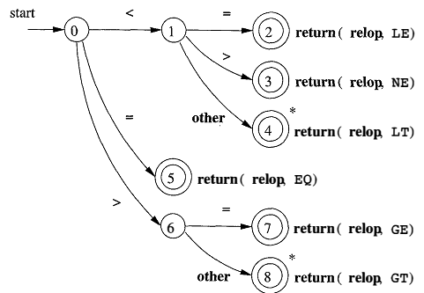
Reading Ahead
A general approach to reading ahead on the input, is to maintain an input buffer from which the lexical analyzer can read and push back characters.

Slide 14
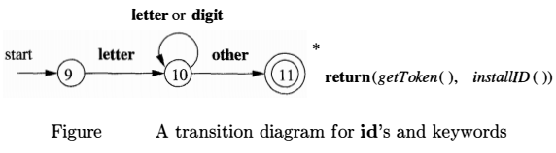
Recognition of reserve words: Method1
If , then or While are reserved word but looks like an identifier.
We use transition graph to search identifier lexemes and recognize reserved words.

Slide 15
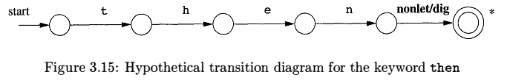
Recognition of reserve words: Method2
Create separate transition diagrams for each keyword

Slide 16
Regular Expression (Java: java.util.regex)
Regular Expressions/ Regex help search token matching complex criteria.
First, the pattern is created using the Pattern.compile() method. The first parameter indicates which pattern is being searched for and the second parameter has a flag to indicates that the search should be case-insensitive. The second parameter is optional.
The matcher() method is used to search for the pattern in a string. It returns a Matcher object which contains information about the search that was performed.
The matches() and find() method returns true if the pattern was found in the string and false if it was not found.

Slide 17
Regular Expression (Java: java.util.regex)
import java.util.regex.*;
public class RegexExample1{
public static void main(String args[]){
//1st way
Pattern p = Pattern.compile(".s");//. represents single character
Matcher m = p.matcher("as");
boolean b = m.matches();
//2nd way
boolean b2=Pattern.compile(".s").matcher("as").matches();
//3rd way
boolean b3 = Pattern.matches(".s", "as");
System.out.println(b+" "+b2+" "+b3);
}}

Slide 18
Lexical Errors
Suppose a situation arises in which the lexical analyzer is unable to proceed because none of the patterns for tokens matches any prefix of the remaining input. The simplest recovery strategy is "panic mode" recovery.
Example:
int a = 5 @ ;
String s = "Hello;
int if = 10;

Slide 19
Remove White spaces, comments
Most languages allow arbitrary amounts of white space to appear between tokens.
Also comments are ignored by parser.
If comments and white space (blanks, tabs, newlines) are eliminated by the lexical analyzer , the parser will never have to consider it.

Slide 20
Remove White spaces, comments
public class removeWhiteSpace {
public static void main(String[] args) {
String str1="Remove white spaces";
//Removes the white spaces using regex
str1 = str1.replaceAll("\\s+", "");
System.out.println("String after removing all the white spaces : " + str1);
}
}

Slide 21
Recognizing Keywords and Identifiers
Languages allow keywords like if, for, while and also identifiers; lexical analyzer will solve this problem by using a table to hold character strings.
The string table can be filled with strings and used in compilation phases by pointer to refer the strings efficiently then strings itself.
Reserved words can be implemented by initializing the string table with the reserved strings and their tokens.

Slide 22

Lexical Analysis
For example,
int position = initial + rate * 60
Lexemes (position,=,initial,+,rate,*,60) are mapped into following tokens –
How to implement it?
<int>
1 | position
2 | initial
3 | rate
SYMBOL TABLE

Slide 23
OUTPUT
Token Stream:
DATATYPE(float)
IDENTIFIER(position)
OPERATOR(=)
IDENTIFIER(initial)
OPERATOR(+)
IDENTIFIER(rate)
OPERATOR(*)
NUMBER(600)
DELIMITER(;)
Symbol Table:
position : ID_1
initial : ID_2
rate : ID_3
Input: Variable Declaration Statement
e.g.
float position = initial + rate * 600;

Slide 24
Assignment : (5 Marks)
Implement a Lexical Analyzer in Java that:
Reads Roman numeral declarations (e.g., int x = X;)
Recognizes tokens such as data type, identifiers, assignment operators, Roman numerals, and delimiters.
Reads for loop declarations and recognizes tokens such as keywords, identifiers, operators, numbers, and delimiters.
Builds a symbol table to store identifiers with unique IDs.
Prints the token stream and symbol table as output.
Input example:
for (int i = 1; i < 10; i++)
Expected token categories:
KEYWORD → for
DELIMITER → ( , )
DATATYPE → int
IDENTIFIER → i
OPERATOR → = , < , ++
NUMBER → 1 , 10
Expected Symbol Table:
i : ID_1

Slide 25
The Lexical- Analyzer Generator Lex

Slide 26
The Lexical- Analyzer Generator Lex
we introduce a tool called Lex, or in a more recent implementation Flex,
that allows one to specify a lexical analyzer by specifying regular expressions to describe patterns for tokens.
The input notation for the Lex tool is referred to as the Lex language and the tool itself is the Lex compiler.
the Lex compiler transforms the input patterns into a transition diagram and generates code, in a file called lex.yy.c

Slide 27
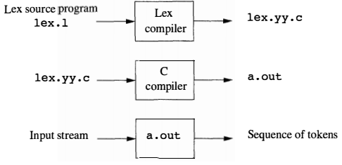
Creating a lexical analyzer with lex

Slide 28
Installation Step FLEX
Download MinGW C Compiler: Click here to download codeblocks-16.01mingw-setup
Download FLEX: Click here to download flex-2.5.4a-1
Set Path for MinGW:
C:\Program Files (x86)\CodeBlocks\MinGW\bin
C:\GnuWin32\bin
Create/Save FLEX files (extension .l) For Example : filename.l
Compile FLEX file on Command Prompt: flex filename.l
Compiler C file on Command Prompt: gcc lex.yy.c
Run C File on Command Prompt: a.exe

Slide 29
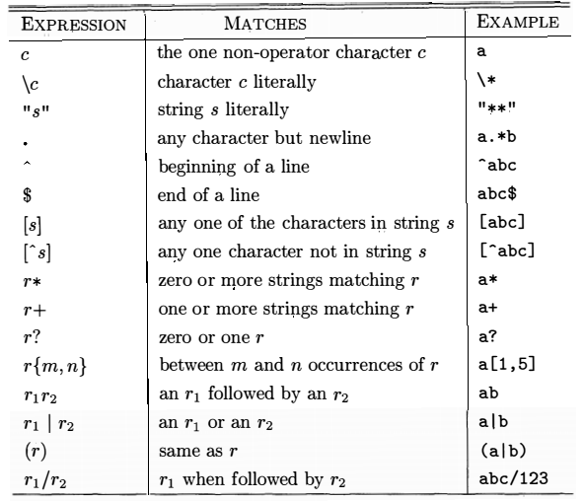
Flex character set

Slide 30
The Role of the Lexical Analyzer
In front-end of compiler the Lexical Analyzer
reads the input characters of the source program,
group them into lexemes, and
produce as output a sequence of tokens
The stream of tokens is sent to the parser for syntax analysis.
It always interacts with symbol table.
If a lexeme approaches to an identifier then It enters lexemes into symbol table.
Information regarding identifier can be referred by LA for proper token identification passed to parser.

Slide 31
The Role of the Lexical Analyzer
It also removes comments and whitespace (blank, newline, tab, and perhaps other characters that are used to separate tokens in the input).
Also show correlated error messages
Keeps track of source code line number to show error with line numbers.
Some time LA is divided into two section
Scanner: only deletes spaces, tabs, comments
Lexical Analysis: produces the sequence of tokens as output .

Slide 32
Lexical Analysis Versus Parsing
Without a lexical analyzer; a parser’s job will be hell, isn’t it?
A parser that had to deal with comments and whitespace as syntactic units if comments and whitespace have not already been removed by the lexical analyzer. Its more complex considerably.
A separate lexical analyzer allows us to apply specialized techniques that serve only the lexical task, not the job of parsing. Specialized buffering techniques for reading input characters can speed up the compiler significantly.
Compiler portability is enhanced. Input-device-specific problems can be restricted to the lexical analyzer.

Slide 33
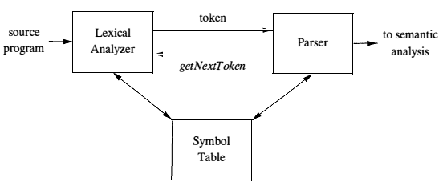
The Role of the Lexical Analyzer

Slide 34
Lexical Errors
Lexical analyzer cannot tell whether fi is a misspelling of the keyword if or an undeclared function identifier.
Simultaneously fi is valid lexeme for the token id.

Slide 35
Lexical Errors
Suppose a situation arises in which the lexical analyzer is unable to proceed because none of the patterns for tokens matches any prefix of the remaining input. The simplest recovery strategy is "panic mode" recovery.
Example:
int a = 5 @ ;
String s = "Hello;
int if = 10;

Slide 36
Lexical Error Handling
Error Reporting: Providing informative error messages with line and column numbers.
Tokenization Rules: Defining clear rules in the lexical specification to prevent such errors from occurring. (such as FLEX rules)
Error Recovery: Attempting to continue parsing after an error, allowing for more errors to be detected in a single pass.

Slide 37
Error Recovery
Most probably the parser will handle this error by transposition method. Other recovery method are:
Delete one character from the remaining input.
Insert a missing character into the remaining input.
Replace a character by another character.
Transpose two adjacent characters.
This transformation method is too expensive.

Slide 38
Solution: Input Buffering
Before recognizing the correct lexeme
We have to use a speedy method for reading source program input.
We often look one or more characters beyond the next lexeme before we can be sure we have the right lexeme.

Slide 39
Buffer Pairs
This method reduce the amount of overhead required to process a single input character.
This scheme involves two buffers that are alternately reloaded.
Each buffer is of the same size N. (4069 bytes)
We read N characters on one call instead of one character on each call.
If input file has less than N characters then it contains eof.

Slide 40
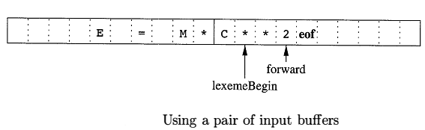
Buffer Pairs
Two pointers to the input are maintained:
Pointer lexemeBegin, marks the beginning of the current lexeme, whose extent we are attempting to determine.
Pointer forward scans ahead until a pattern match is found;
Once the next lexeme is determined, forward is set to the character at its right end.

Slide 41
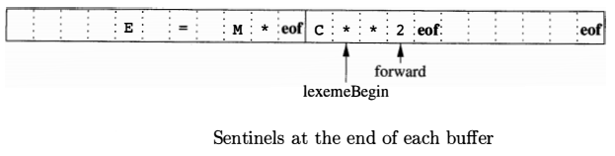
Sentinels
eof character is used at the end of each buffers
Any eof that appears other than at the end of a buffer means that the input is at an end.
Multiway branching of forward can be handled easily by using both eof.

